Slide 1
Provider Training 2022

Slide 2
OBJECTIVES
On Completion, the participant will be able to
Identify and understand SMHW Eligibility Criteria
Identify information required to bill SMHW claims for client with high deductible insurance
Define acceptable timeframes for billing completed claims
Determine which form type is appropriate for the MOHSAIC entry of screening and diagnostic mammograms
Select the correct visit type based on program definitions

Slide 3
ADDITIONAL TOPICS
CDC’s High Risk Criteria For Breast and Cervical Cancer Screening
Screening Mammograms for women under 50 years of age
Mammography Van Screening
Common errors found in billing for Screening vs. Diagnostic Exams
Breast and Cervical Cancer Treatment (BCCT) Guidelines
American Society for Colposcopy and Cervical Pathology (ASCCP) Information
Transportation Voucher

Slide 4
SMHW BASIC ELIGIBILITY CRITERIA
Age 35-64
Meet income guidelines
Underinsured or Not insured
Health Insurance does not cover services/Unable to pay deductible
Has MO HealthNet with a spend-down, but has not met the spend-down
Income eligible for Medicare Part B, but unable to pay premium (Medicare Part B covers breast and cervical cancer screenings)
Client Eligibility is in SMHW Manual Section 3
Notes:
If the client has Part B Medicare benefits, they are not SMHW eligible. 3.1 & 3.2 Adjusted gross income on a tax return or net amount on a pay stub determines income eligibility. For FY23 Federal Poverty Level is changing to 250%. Client must verbalize they can’t pay their deductible or spend-down.

Slide 5
ELIGIBILITY EXCLUSIONS
Women who have a diagnosis of breast or cervical cancer are not eligible for Show Me Healthy Women
Women currently being treated for breast or cervical cancer are not eligible for SMHW
Women enrolled in prepaid/managed care and health plans, such as Health Maintenance Organizations [HMOs], Point of Service Plans [POS]
Women with full MO HealthNet (ME Code 05) or (ME Code E2)
Client Eligibility is in SMHW Section 3

Slide 6
HEALTH INSURANCE
Show Me Healthy Women and WISEWOMAN programs are the payers of last resort
A client’s insurance must be billed first. Once the Explanation of Benefits (EOB) has been received, list the dollar amount the insurance paid for each procedure with the corresponding CPT code in the comment section of the MOHSAIC form
Show Me Healthy Women and WISEWOMAN will only reimburse up to the total amount allowed for the procedure per program guidelines
Eligibility is in SMHW Manual Section 3
Notes:
Remember, hold the claim until you have received the EOB. If you are approaching the 60 day mark on entering the claim and still waiting on the EOB, call the RPC or Central Office to discuss. Include the TC and 26 code amounts with CPT codes when submitting.

Slide 7
CLIENTS WITH HIGH DEDUCTIBLE HEALTH INSURANCE (EXAMPLE)
CPT Code: 77066 $ 186.00 Mammography, diagnostic follow – up (bilateral)
CPT code: 76641 $ 62.25 US, complete
CPT code: 19100 paid zero Breast biopsy
Eligibility is in SMHW Manual Section 3 and CPT Codes Section 9. 7 – 9.13
Notes:
CPT Codes; 9.7 – 9.13 Remember, the 26 and TC codes.

Slide 8
BILLING TIMEFRAMES
Completed forms are to be submitted into MOHSAIC within 60 days of service
Completed forms submitted beyond 60 days may be considered ineligible for reimbursement
Submit final billing within 30 days of the closing of the grant year. Data submitted after that deadline cannot be reimbursed by SMHW or billed to the client
Reminder: The grant year (FY 22) closes June 29, 2022.
Section 9 SMHW Manual Billing Guidelines
60
Days
Notes:
*End of grant year form submissions in MOHSAIC will have to be submitted in less than 60 days from date of service prior for reimbursement.
If you are waiting on a response from another provider and coming close to exceeding the 60 day deadline, please contact RPC or central office for guidance.

Slide 9
SMHW – MOHSAIC FORM BASICS
Types of Forms:
Green
Green - History
Blue - Screening Report
Purple – Breast Diagnostic
Yellow – Cervical Diagnostic
Gray - Patient Navigation
Blue
Purple
Yellow
Gray
Other forms needed for client’s file:
Eligibility form, Proof of Age-Photo ID and Proof of Income-Tax form/paycheck stubs
SMHW Manual Section 10 Forms
Notes:
Green-first form that needs to be entered into MOHSAIC with each annual screening. SSN is recommended but not required. SSN is required for full BCCT Medicaid coverage. Date of last mammogram and date of last pap must be completed. Ask about the last date of mammogram/pap.
Blue- enter screening visit information from clinical well woman visit notes. Assess breast concerns/perform exam/assess high risk and document results. If abnormal dx work up should be planned.
Purple –diagnostic mammogram performed after an abnormal CBE is entered. If bilateral is required, report right and left breast, if unilateral only perform and report on affected breast.
Yellow- diagnostic clinical cervical management after abnormal cervical results. Follow ASCCP guidelines. www.asccp.org Gray- Patient Navigation or Navigation-Only. A minimum of 2 contacts must be completed for a $50.00 reimbursement. All Navigation clients must have a completed screening and/or diagnostic forms entered into MOHSAIC to provide data that services were completed.

Slide 10
SCREENING (BLUE) FORM VISIT TYPES
Visit Types are in SMHW Manual Section 4
Notes:
Example of an initial screening (blue) form in MOHSAIC.
Initial-(CBE (clinical breast exam) &/or Pelvic) , Annual-(CBE &/or Pelvic), Annual CBE only- (CBE only), Initial CBE only- (CBE only), Initial vs Annual: Initial first SMHW contact or if it’s been 5 years since last SMHW screening. Annual: SMWH defines an annual screening to be 10 months or greater from the initial screening or previous annual screening. Annual Rescreen- SMHW defines a rescreen visit resulting from an abnormal initial or abnormal annual screening that is less than 10 months from an initial or annual screen date. Note: If there is a delay in the rescreening visit for 10 months or more from the date of the annual/initial visit, reimbursement occurs only after the rescreen meets breast/cervical criteria for an annual screening. Mammogram Only- only for entry of a Screening mammogram or mammogram van visit. Navigation Only: SMHW woman that is entered into SMHW or Navigation Only, meets SMHW age/income requirement but has insurance to pay for screening or diagnostics.

Slide 11
SMHW – MOHSAIC FORM ENTRY BASICS
INITIAL vs. ANNUAL vs. RESCREEN visit types
Initial – First time to enroll in SMHW with the provider or greater than 5 years since last
SMHW visit with the same provider (Initial or Initial CBE only)
Note: Even if the patient has been seen by the provider for multiple years – the
FIRST time the client enrolls with a SMHW provider it is an INITIAL visit
Annual – Any future SMHW visits or tests with the SMHW provider (Annual, Annual CBE only)
Note: Annual screening is 10 months or greater from the initial or the last annual visit.
Rescreen – A rescreening visit can be done with an abnormal result that is less than 10 months from an initial or annual screen date. A rescreen CBE can be performed after 14 days or within 10 months of an initial CBE with the first time reported pain/tenderness or a CBE deemed suspicious for cancer and after diagnostic testing confirms a non-cancer diagnosis.
Visit Types are in SMHW Manual Section 4

Slide 12
SMHW – MOHSAIC FORM ENTRY BASICS (CONTINUED)
RESCREENING NOTE:
Can be used when entering a 6-month follow up diagnostic mammogram or rescreen CBE or cervical abnormalities after benign diagnostics.
If there is a delay in the rescreening visit for 10 months or more from the date of the annual/initial visit, reimbursement occurs only after the rescreen meets breast/cervical criteria for an annual screening.
A repeat pelvic exam is optional as a rescreen in less than ten (10) months if the previous abnormal pelvic exam reported to SMHW was not within normal limits due to an abnormal cervical finding.
Visit Types are in SMHW Manual Section 4
Notes:
Always follow ASCCP guidelines when providing care for cervical diagnostics and treatment.
All Navigation clients must have complete screening and/or diagnostic forms entered in MOHSAIC to provide data that services were completed. A minimum of 2 contacts must be completed for reimbursement. In order to get the $50 reimbursement of navigation you must select one or both of the following in the final outcomes (Section E) (back of page). Screening completed - cervical and/or breast screening completed. All outcomes that apply should be selected but these are the only 2 that will generate the $50 reimbursement. SMHW will verify that a blue screening form has been entered with complete results prior to paying for navigation claim form in MOHSAIC.
Rescreen information is covered in Section 4.2 and Section 5.3 and 5.10

Slide 13
SMHW OTHER VISIT TYPES (CONTINUED)
Mammogram Only – only for the entry of a screening mammogram and the CBE is done elsewhere or a mammogram van visit.
Navigation Only – Navigation-only allows payment for navigation services provided to a woman who meets age and income requirements and has group or private insurance to pay for the screening/diagnostic services. This navigation only will need to be entered as reporting only (R/O).
Visit Types are in SMHW Manual Section 4
Notes:
Navigation Only is the way it is entered into form types. Navigation includes SMHW eligible patients.

Slide 14
HIGH RISK SCREENING FOR BREAST CANCER
During the visit, screen the patient and document a high risk assessment. If the patient meets the high risk criteria (next slides) the program may pay for an MRI.
SMHW will pay for an annual screening breast MRI as funding is available (with prior approval)
Contact your RPC or Central Office to request MRI approval. Document the approval in the Comment’s section of the claim form.
High Risk are in SMHW Manual Section 4
Notes:
Section 4.5
**An annual CBE should occur for the client to remain complaint with SMHW requirements. Program manager screening MRI approvals are based on the availability of funds. Remember to request permission from the program manager if you have a client that is high risk and clinician recommends a screening MRI. If you request a screening MRI approval, you will receive an emailed response with either the approval or denial. High Risk must be from an approved risk assessment model for High Risk Breast Cancer.

Slide 15
HIGH RISK CRITERIA FOR BREAST CANCER (CONTINUED)
The HIGH RISK section should be marked YES if there is a:
Known genetic mutation such as BRCA 1 or 2
First-degree relative whom is a BRCA carrier (parent, full sibling or biological child)
Lifetime risk of 20 - 25% or greater as defined by risk assessment models such as BRCAPRO, Tyrer-Cuzick or GAIL
If these criteria are not evident, mark NO.
If the clinician did not assess a patient for risk or high risk for breast and/or cervical
cancer is unknown, mark NOT ASSESSED/UNKNOWN.
High Risk Criteria are in SMHW Manual Section 4
Notes:
The breast section is B4; on the screening (blue) form.

Slide 16
HIGH RISK CRITERIA FOR CERVICAL CANCER
The HIGH RISK section should be marked YES if the client has:
Human Immunodeficiency Virus (HIV)
Had an organ transplant
Immunocompromised with another health condition
Diethylstilbestrol (DES) exposure in utero
If these criteria are not evident mark NO.
If the clinician did not assess a patient for risk or high risk for breast and/or cervical cancer is unknown, mark NOT ASSESSED/UNKNOWN.
High Risk are in SMHW Manual Section 4
Notes:
Cervical is on the back of the blue screening form at the top far right corner under section C.

Slide 17
SCREENING MAMMOGRAMS UNDER 50
As funding allows, prior authorization requests for screening mammograms for SMHW clients ages 40-49 may be e-mailed to:
SMHWAuthorization@health.mo.gov
The provider will receive an emailed response from SMHW with an approval or a denial.
Approval is dependent upon availability of funds.
Screening Mammograms under 50 is in the SMHW Manual Section 4.5-4.6
Notes:
Other funding options:Hope for You, CR breast Community, BCLP or GR.
If you have questions regarding other funding sources, please call your RPC or Central Office.
Generally, the email is open from August to March. Program manager will send out an email when the inbox opens and closes.

Slide 18
SCREENING MAMMOGRAMS UNDER 50 (CONTINUED)
When emailing SMHW for a screening mammogram approval, be sure:
The client is 40-49 years old at the time of the screening mammogram
To provide client’s date of birth (DOB)
The client is a Missouri resident
Screening Mammograms under 50 is in the SMHW Manual Section 4.5-4.6
Notes:
Section 4.6 in Table 1 at the bottom.
Client must have a Social Security Number but it does not have to be submitted with the email. The SSN must be submitted on a claim form for reimbursement.

Slide 19
SCREENING MAMMOGRAMS UNDER 50 (CONTINUED)
The client has a Social Security Number (SSN)
To include the date of service (DOS)
To include the organization’s name
Note: Receive Prior Authorization approval before
performing the screening mammogram.
Screening Mammograms under 50 is in the SMHW Manual Section 4.5-4.6
Notes:
After a request is submitted, you will receive an emailed response with an approval or a denial. With an approval, document this in the comments section of the blue screening form when the screening mammogram is completed.

Slide 20
MAMMOGRAPHY VAN SCREENING GUIDELINES
Meeting quality care guidelines and program requirements it is recommended the mammography van coordinate with primary care services for documentation of the clinical breast exam (CBE).
If a client presents at the mammography van and has not had a CBE, continue with screening services but refer them for primary care services so a CBE can be obtained.
Document the patient education regarding the CBE and where the CBE was or will be performed.
SMHW reimburses the provider for the office visit performing the CBE.
Mammography Van Guidelines are in the SMHW Manual Section 9
Notes:
See Section 9.5 & 9.6. Please refer them and document in the comments section (D) of the form

Slide 21
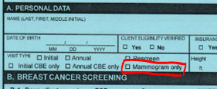
REPORTING SCREENING MAMMOGRAPHY VAN ONLY
For Mammography Van providers, when billing for a screening mammogram only select the visit type as “Mammogram Only”, mark the “Mammography Van” box and complete “Section B5 Mammography provider facility” field (paper form)
Include the name of the facility providing the van and include the word “Van” by the facility name
Example: Ellis Fischel Van
BLUE FORM- PAPER
BLUE FORM-MOHSAIC
Notes:
In MOHSAIC – this is reported in SECTION A to select mamm only, then section C to include all the results/information.
On paper the mammogram results on the Blue screening form are listed under section A to choose mamm only. Then section B5 for results and rest of the information.
Mammogram Only visit type is also used by Mammogram Facilities to report Screening mammograms, it does serve a dual purpose.
If Mammogram Van only visit, remember to document the education and referral offered for the client to receive a CBE in the comments section (D).
Missy’s thought. Slides 16-18:Some food for thought for us to remember if asked during the presentation (not necessarily add to slide)… Screening providers that subcontract mammogram services with other hospitals also use the “mammogram only” visit type when the CBE cannot be reported on the same Screening form as the screening mammogram. This can occur when: 1) the CBE and screening mammogram occur in different grant years, 2) if the screening mammogram was delayed in completion so the provider goes ahead and submits the CBE portion to meet billing guidelines & then the screening mammogram is reported later. The other intention with Mammogram only visit types is to prevent duplicate CBE entry by the direct biller trying to enter the mammogram and re-reporting the CBE already completed by screening provider. (duplicate CBE entries cause MDE errors).

Slide 22
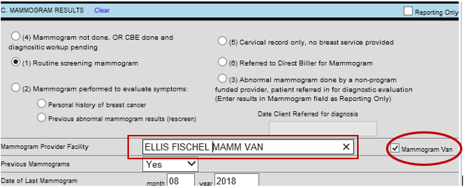
EXAMPLE OF REPORTING SCREENING MAMMOGRAM ON MAMMOGRAPHY VAN
PAPER FORM
MOHSAIC FORM
Notes:
These slides show what the paper (blue screening form) and MOHSAIC (computer) will look like when you complete and then enter.

Slide 23
SCREENING FORM VS. BREAST DIAGNOSTIC FORM
Used for entry of a screening mammogram with negative or normal CBE/SBE findings
OR
Used for the entry of a 6 month diagnostic mammogram rescreen (typically in response to a previous “probably benign result or Cat 3 imaging”)
Used for entry of diagnostic mammogram with positive or abnormal CBE/SBE findings
Refer to Forms

Slide 24
REPORTING DIAGNOSTIC RESCREEN (MAMMOGRAM)
Notes:
Example of the blue form with the visit type. Section A (top of the blue screening form). Remember from earlier a drop down box with the various visit types, select rescreen. This will be the only time a diagnostic mammogram will entered on a blue form. (6 month rescreen)

Slide 25
MAMMOGRAM RESCREEN SECTION
Rescreen review is in Section 4 of the SMHW Manual
Notes:
Previous abnormal mammogram results (rescreen). Section 4 of SMHW manual, This is an example of how to report a 6 month follow up diagnostic mammogram. Must be reported on a blue form and the visit type will be a rescreen.

Slide 26
BREAST AND CERVICAL CANCER TREATMENT ACT (BCCT) GUIDELINES
Client is enrolled in SMHW prior to tissue biopsy and has a screening or diagnostic test paid by SMHW
Please note: If the only service reimbursed by SMHW is a referral fee, the client will not be eligible for BCCT
Legal Missouri resident with a social security number
Female
Age 35 to 64
Need treatment for breast and/or cervical cancers or precancerous conditions listed on the next slide
BCCT is in SMHW Manual Section 7
Notes:
Reminder: When considering BCCT eligibility the patient has to be enrolled in SMHW prior to a tissue biopsy and a screening diagnostic test paid for by SMHW. If a referral fee is the only paid service they are not BCCT eligible. The clinician should remember this when further treatment is required to ensure the patient has the availability of BCCT if they have a diagnosis of breast/cervical ca. A breast u/s is required for a woman to be considered eligible for BCCT, paid through SMHW and a qualifying result of category 4.

Slide 27
BCCT GUIDELINES (CONTINUED)
Diagnosed with breast and/or cervical cancer, or cervical precancerous condition through a SMHW provider
No source of health/medical insurance that covers treatment (even if a high deductible/Affordable Care Act)
Meet SMHW eligibility guidelines
Need treatment for breast and/or cervical cancers or precancerous conditions listed on the next slide
BCCT is in SMHW Manual Section 7

Slide 28
CLINICAL QUALIFIERS FOR BCCT
Breast
Cervical
Ultrasound of “suspicious abnormality”(BI-RADS category 4) or “highly suggestive of malignancy” (BI-RADS category 5) *ELIGIBLE FOR PRESUMPTIVE BCCT
Carcinoma in situ *ELIGIBLE FOR FULL BCCT
Invasive breast cancer *ELIGIBLE FOR FULL BCCT
CIN 2/moderate dysplasia *ELIGIBLE FOR FULL BCCT
CIN 3/severe dysplasia *ELIGIBLE FOR FULL BCCT
CIS or AIS *ELIGIBLE FOR FULL BCCT
Invasive cervical cancer *ELIGIBLE FOR FULL BCCT
A presumptive BCCT application SHOULD always be submitted first
BCCT is in SMHW Manual Section 7
Notes:
SMHW funding pays for the colposcopy; LEEP and cold knife are typically paid by BCCT funding. (pg 6.6) Algorithms for Cervical Diagnostic Services are available for viewing at http://www.asccp.org/Default.aspx.
CIN- Cervical Intraepithelial Neoplasia- classified according to how much epithelial tissue is affected.
AIS- Adenocarcinoma in situ-of the uterine cervix is caused by infection with HPV. (it is a precursor of invasive adenocarcinoma of cervix)
A temporary BCCT application should ALWAYS precede a FULL BCCT application to ensure the client receives coverage quickly. Presumptive (PE)(Temporary) BCCT (ME83) covers the client from the date of qualifying test to the last day of the following month. This coverage will end at that time unless FULL BCCT (ME84) application is submitted. FULL BCCT applications are usually only needed with a confirmed tissue biopsy diagnosis of breast/cervical cancer or CIN2/3 (precancerous) conditions that requires treatment beyond the PE BCCT time frame. REMEMBER: A breast ultrasound is required for a woman to be considered for eligibility for BCCT, paid for through SMHW.

Slide 29
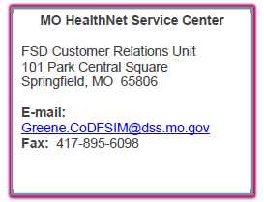
PRESUMPTIVE (PE) BCCT FORM
Correct address
DCN REQUIRED
DATE ENROLLED
IN SMHW
START DATE OF
COVERAGE IS DATE
OF QUALIFYING TEST
BCCT is in SMHW Manual Section 7
Notes:
PE BCCT example form for Scenario.
Remember to complete a PE BCCT application with Start Date of Coverage being the date of the BIRAD 4 Ultrasound. The CLIENT DCN must also be on the form and can be obtained thru eMOMED or by registering the SMHW client in MOHSAIC.
The Specialist consult will be covered by BCCT if it occurred after the Ultrasound.
Completion of the PE BCCT or BCCT application should be done by the SMHW provider or SMHW Direct Biller that completes the qualifying test.
St. Joseph Customer Service Center is incorrect. Send to Greene Co. FSD by email or fax. (Read off the correct address info. In box)

Slide 30
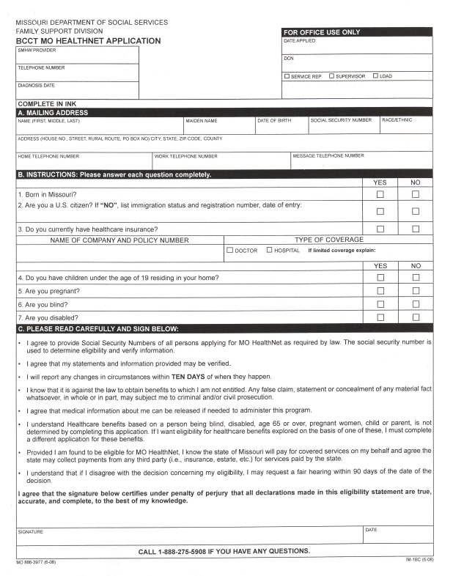
(FULL) BCCT/ BREAST AND CERVICAL CANCER TREATMENT ACT APPLICATION
Once a client is enrolled into BCCT, they are qualified for full MO HealthNet benefits, as well as medical services for cancer care.
Refer to form
Notes:
Important reminders: MUST put DCN on form in upper right corner (even though it says “For Office Use Only”. Also make sure SMHW Provider, Telephone number and Diagnosis Date is completed in Upper Left Corner.) At this time, the link on SMHW website takes you to the full Medicaid application, you can request a BCCT form from SMHW or you may have downloaded your own copy. Medicaid is aware and we are working with them to clarification.

Slide 31
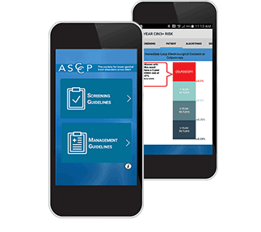
AMERICAN SOCIETY FOR COLPOSCOPY AND CERVICAL PATHOLOGY (ASCCP) CONSENSUS GUIDELINES
An American Society for Colposcopy and Cervical Pathology (ASCCP) user friendly app for guidelines for managing abnormal cervical cancer screening test. Guidelines and algorithms can be viewed at https://www.asccp.org. The mobile phone application is located at https://www.asccp.org/mobile-app. (Mobile App – ASCCP)
ASCCP Consensus Guidelines Section 6
Notes:
In providing cervical care coordination, review the claim carefully when entering into MOHSAIC. This site is helpful in accurately determining appropriate clinical management. If there are questions, please contact your local RPC or Central Office. If ASCCP guidelines for clinical cervical management are not followed, the claim will be denied and the client can not be billed.

Slide 32
CERVICAL RESCREEN
Pelvic Examination:
A repeat pelvic exam is an option as a rescreen in less than ten (10) months if the previous abnormal pelvic exam was not within normal limits due to an abnormal cervical finding.
Pap Test:
Reimbursement occurs when a pap test is in accordance with the ASCCP guidelines.
HPV DNA genotyping is not considered the same as HPV testing. SMHW does reimburse for HPV DNA genotyping.
HPV DNA specific genotyping 16/18 is an ASCCP option that recommends being done with normal pap/HPV positive results to determine if further diagnostic follow-up is needed. Or, the provider can choose not to do genotyping and co-test (pap/HPV) in one year. Both are acceptable ASCCP options.
Reporting Directions:
Report a rescreen pap test on a blue screening form (pages 10.10) with the category “Rescreen” marked in the “Visit type” box. If rescreen results are suspicious for cancer, proceed with diagnostic procedures as indicated by ASCCP guidelines.
Notes:
• See link to ASCCP Guidelines on page 6.7.

Slide 33
CERVICAL ABNORMAL SCREENING RESULTS
Suspicious screening results will be determined as normal or abnormal through short-term rescreen or diagnostic procedures.
Notify and explain to the client with abnormal findings the need for any additional diagnostic service(s).
SMHW requires two documented attempts for client follow-up, on abnormal results.
Direct telephone communication has been shown to be the most effective contact.
Cervical Information is in Section 6.8 and 6.9

Slide 34
CERVICAL ABNORMAL SCREENING RESULTS (CONTINUED)
If unable to reach client by telephone, a letter should be sent indicating there is need for additional diagnostic testing or treatment. For legal purposes, providers are encouraged to use a certified letter.
If no response is received after the second attempt or the client refuses further diagnostics and/or treatments, notify your RPC.
If abnormal screening results are pending for ten (10) months or longer, client eligibility must be checked and a new annual screening test must be performed prior to the initiation of further diagnostic studies.
SMHW will only reimburse for additional diagnostic services if the client continues to meet SMHW eligibility guidelines.

Slide 35
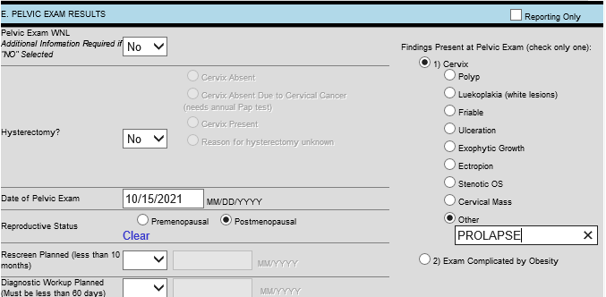
PELVIC EXAM RESULTS ON BLUE SCREENING FORM
Notes:
An abnormal pelvic finding may be placed in the OTHER free text box. The OTHER box should only be use to describe a CERVICAL finding. Findings such an uteran prolapse, vulvar cyst, etc. should not be entered here but can be mentioned in Comments.

Slide 36
TRANSPORTATION VOUCHER
Free transportation is available for SMHW participants. Ask the client if she requires transportation, if she does, document in the patient chart when you arrange the transportation
Transportation is in SMHW manual Section 3
Notes:
Section 3. SMHW has several counties without providers at this time, if the client lives in an area without coverage, call the RPC to discuss options. SMHW has other avenues to assist a client in gaining transportation to appointments.

Slide 37
SCENARIO
Nancy Jones, age 40, comes to your clinic for her “Initial” SMHW well woman exam. She is determined to be eligible.
Ms. Jones reports a right breast lump, the clinician finds a lump in the right breast.
A bilateral diagnostic mammogram and ultrasound is ordered.
Question #1: Should you request a prior authorization for the diagnostic mammogram?
Notes:
Answer to Question #1: NO- no PA is needed for Diagnostic follow up on SMHW clients. PA is only required for SMHW client age 40-49 needing a SCREENING mammogram or a High Risk Screening MRI PA.

Slide 38
MOHSAIC SCREENING FORM (BLUE)
Notes:
Here’s what the screening form would look like for Nancy Jones- CBE only clinical exam. (IF CBE is on the form, it cant be a mamm only, but a CBE only can contact a CBE and Mamm but NO PELVIC. In SECTION C Mammogram Results: With an abnormal CBE exam, the Provider will select (4) if reporting Diagnostic test results from a Subcontracted facility on the Purple form OR (6) “Referred to Direct Biller for Mammogram” if referring the client to a SMHW Direct Biller for Diagnostic mamm/US that will be submitted by the Direct Biller (i.e.: Ellis, Barnes, Bothwell, Truman, etc.).

Slide 39
SCENARIO (CONTINUED)
Diagnostic mammogram results: Left breast-Benign Finding/BIRAD 2. Right breast-Suspicious Abnormality/BIRAD 4. Ultrasound results: Left - category 2, Right - category 4
Question #2: Should you generate a referral for Presumptive BCCT at this time?
The clinician determines the client needs a Specialist Consult and is referred to Barnes-Jewish Hospital.
Notes:
Diagnostic mammogram results: Left breast-Benign Finding/BIRAD 2. Right breast-Suspicious Abnormality/BIRAD 4.
Ultrasound results: Left - category 2, Right - category 4—The ultrasound is the key, for BCCT. The mammogram results do not qualify the patient for BCCT, the ultrasound results do (just talking Presumptive BCCT). Always submit a Presumptive BCCT form first.
Question #2- Answer –YES Complete a PE BCCT application with Start Date of Coverage being the date of the BIRAD 4 Ultrasound. The CLIENT DCN must also be on the form and can be obtained thru eMOMED or by registering the SMHW client in MOHSAIC.
The Specialist consult will be covered by BCCT if it occurred after the Ultrasound.
Completion of the PE BCCT or BCCT application should be done by the SMHW provider or SMHW Direct Biller that completes the qualifying test.

Slide 40
MOHSAIC BREAST DIAGNOSTIC FORM (PURPLE)
TEST SCENARIO
ONLY
Notes:
Diagnostic mammogram and ultrasound reporting. Ultrasound results: Left - category 2, Right - category 4
Make sure to check tomosynthesis if this was performed with the Diagnostic mammogram.
Since the BIRAD 4 Ultrasound qualifies for PE BCCT coverage, all dx testing (consult/biopsy) reported on a Purple Dx form will be “reporting only” and should be covered by PE BCCT (83) or BCCT (84)- depending on the final diagnosis.

Slide 41
SCENARIO (CONTINUED)
Question #3: How can the referring clinic ensure complete case management for this SMHW client?
Notes:
Question #3- The referring clinic must assure through case management that the client completes diagnostic imaging and further consultation and/or biopsy. The referring clinic should be provided all documentation/medical reports from Subcontract or SMHW Direct Biller providers. It is important to receive results and have the information documented.

Slide 42
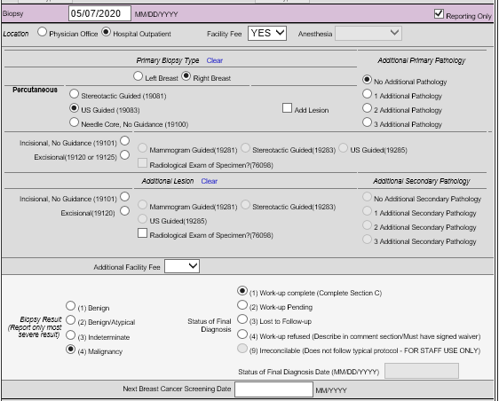
MOHSAIC BREAST DIAGNOSTIC FORM PURPLE (CONTINUED)
TEST SCENARIO
ONLY
Notes:
Since the BIRAD 4 Ultrasound qualifies for PE BCCT coverage, all testing after that (consult/biopsy) reported on a Purple Dx form will be “reporting only” and should be covered by PE BCCT (83) or BCCT (84)- depending on the final diagnosis. Reporting Only, is used for reporting only purposes, it will not assign a payment amount for reimbursement. This slide shows reporting of the Specialist Consult visit at Barnes along with the Ultrasound Guided Percutaneous (Needle-Core) Biopsy & Biopsy result. Once a tissue biopsy is completed with final diagnosis, Work Up Complete should be marked. Gather all the information before submitting to SMWH.

Slide 43
BREAST DIAGNOSTICS FORM (PURPLE) CONTINUED
TEST SCENARIO ONLY
Notes:
This shows the bottom of the form with the Final Diagnosis, Dx Date, Treatment information and Comments.
These claim forms were submitted after all the information was gathered. Treatment should be started within 60 days of cancer diagnosis.

Slide 44
BREAST DIAGNOSTIC FORM PURPLE (WORK UP PENDING)
This results in errors in information submitted to the Centers for Disease Control (CDC). It appears the client was left with a malignant diagnosis and no further treatment.
This claim is in completed status. It captures the complete clinical picture from abnormal screening to treatment.
This case is now error free per CDC standards.
Test Scenario Only
Notes:
Shows the importance of marking a form correctly as “WORK UP COMPLETE” after diagnostic imaging and/or biopsy diagnosis is completed vs. “WORK UP PENDING” to prevent MDE errors. Slide on the left has a line drawn through to indicate this is an incorrect choice. Work up pending will create an MDE error, if there is not a work up complete form submitted as well. A work up pending form will create an MDE error.

Slide 45
PREVIOUS SCENARIO WITH NEW CIRCUMSTANCES
Instead, Ms. Jones doesn’t answer her phone. You leave a voicemail, but do not receive a return call. A week goes by, and you call Ms. Jones again. This time she answers and agrees to come back in for the biopsy after a great deal of persuasion and education. You learn Ms. Jones’ mother died of breast cancer at age 45.
The date of the biopsy, Ms. Jones is a no-show. You reach out to her again and the biopsy is rescheduled for Friday of the same week. Again, she is a no-show.
Two documented contact attempts are made the following week by voicemails without a response. It has now been 3 weeks since the 2nd no show. You send Ms. Jones a certified letter, but still no response.
Question #1: What is your next course of action for this client?
Notes:
Question #1 Answer: contact RPC to inform them . The initial screening clinic should enter LTFU into MOHSAIC.
This is discussing a LTFU for completion of Dx work up/Final Diagnostic Diagnosis. Remember Ms. Jones received a screening mammogram only, she never showed for the diagnostic/biopsy.

Slide 46
NEW CIRCUMSTANCES (CONTINUED)
Contact your SMHW Regional Program Coordinator (RPC). The RPC sends a certified letter to the client. The client is considered “lost to follow-up”.
The program recommends a minimum of two weeks and a maximum of 3 months for a response.
Notify the Regional Program Coordinator if no response received from the client. The Regional Program Coordinator should always receive notification when a client is unreachable.
Notes:
The initial screening clinic should enter LTFU into MOHSAIC. The next step in the process would have been a diagnostic procedure, a diagnostic form will need to be submitted as LTFU. This is an example of a breast LTFU, but cervical diagnostic LTFU could be the appropriate process as well. The RPC will also send a certified letter and keep on file. Make a minimum of two documented attempts to contact the client. One of these attempts must either be in writing and sent as a certified letter or sent via client portal/email with a read receipt confirmation.

Slide 47
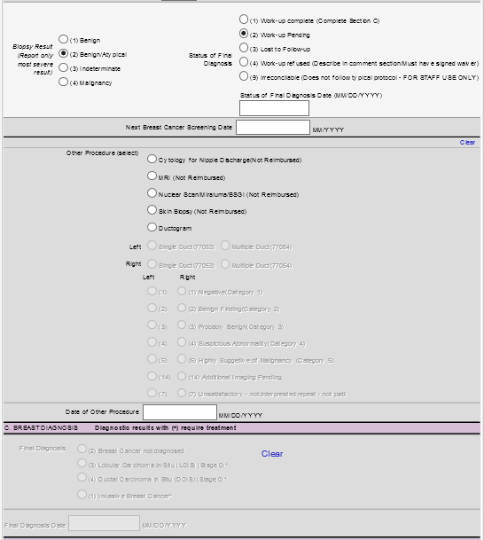
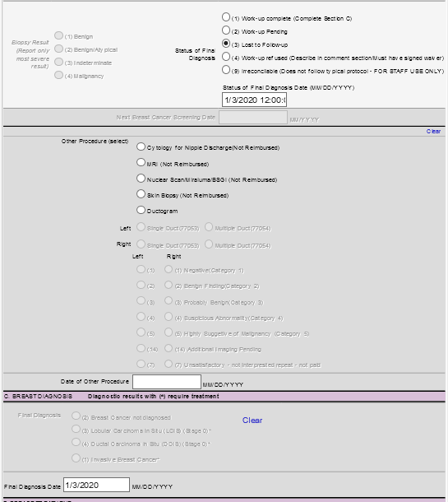
EXAMPLE OF LOST TO FOLLOW UP
This results in errors in information submitted to the Centers for Disease Control (CDC). It appears the client was left with a malignant diagnosis and no further treatment.
This claim is in a completed status. It captures the complete clinical picture from abnormal screening to lost to follow-up.
This case is now error free per CDC standards.
Notes:
Choosing LTFU will complete the cycle of treatment for the client. A LTFU claim must be entered to complete the cycle of care in MOHASIC for breast and cervical cancer cases that don’t complete diagnostic services. You can document all attempted contact info in the comments section (D) as well.
Complete the LTFU on the purple/yellow diagnostic form; it would have been the next step after the blue screening form if the client would have followed through with care. Slide on the left has a line drawn through to indicate this is an incorrect choice. Show Me Healthy Women (SMHW) will often ask for additional information to complete a missing piece in a claim form.
Please respond to SMHW when information is requested. If the client is lost to follow up (LTFU) and doesn’t complete diagnostic treatment and is unreachable to complete diagnostic treatment, the provider should enter the lost to follow up on a purple breast diagnostic or yellow cervical diagnostic form.
Always notify the RPC/Central Office if a patient is lost to follow up. The RPC will send a letter to the patient in an effort to get the patient to follow through with services. Lost to follow up is located in SMWH Manual 5.19 and 6.8 – 6.9

Slide 48
COMPLETE CASE COMMENTS
NO
YES
Notes:
This slide is one example of entering detailed informative comments. Detailed comments are needed for services to be paid with GR or Donated Funds; Case Management interactions of a Client with No-show or rescheduled appointments; LTFU cases; or cases that explain unusual situations such as needing multiple biopsies or clinical management delays. When entering claims please use detailed informative comments for SMHW to review. This will decrease the rate of MDE errors.

Slide 49
MOHSAIC SCENARIO
Client 1: Suzy Sample, 53 years old
Enrolls in SMHW at St. Louis Care Clinic
First enrolled with SMHW at this clinic three years ago
CBE is normal
Pelvic normal
PAP with HPV completed & both negative
Last PAP was January, 2018
Screening mammogram is ordered and completed by a direct biller facility - HealthOne Breast Center. Bilateral BIRAD 2-benign results.
Last mammogram was April, 2019
Suzy Sample
What type of visit is this?
Notes:
Answer: Annual
To qualify for an initial visit it must be 5 years since the last time enrolled in SMHW.

Slide 50
MOHSAIC SCENARIO
Client 2: Sami Smith, 39 years old
First time to St. Louis Care Clinic and first time being enrolled into SMHW.
Here for her yearly well woman exam
Last breast, pelvic and pap were two years ago
History of HPV positive result in 2021 at non-SMHW provider
What services can SMHW provide this client? Recheck pap, pelvic, HPV and breast exam.
Form type is initial. Consider submitting a Patient Navigation form.
Notes:
Regardless of the date of any previous services, this example states Sami Smith is new to St. Louis Care Clinic and the SMHW program. This makes it an initial visit and she can have all services completed as an initial visit.

Slide 51
(Continued): Sami Smith, 39 years old
CBE
Pelvic exam
PAP with HPV
Clinical Exam:
CBE – normal
Pelvic exam – normal, cervix present
PAP – LSIL
HPV – positive
Client scheduled for a colposcopy
Notes:
Based on ASCCP guidelines, client should receive a colposcopy. Remember the ASCCP website for assistance.
Follow up should continue based off test results of colposcopy, ASCCP guidelines and clinician direction. Remember prior history is now a factor in determining clinician management, review the ASCCP guidelines.

Slide 52
MOHSAIC SCENARIO TO CHECK FOR ERRORS
Please remember to check the Diagnostic Work Up Planned section (F on the blue screening form in MOHSAIC) when entering abnormal cervical results.
In the following example, a patient was seen by a provider with abnormal cervical results that were entered incorrectly.
Notes:
Section C4 on blue screening form on paper

Slide 53
MOHSAIC SCENARIO TO CHECK FOR ERRORS (CONTINUED)
This is incorrect.
Notes:
This is incorrect, in entering information. The patient should and did indeed have diagnostic work up planned. MOHSAIC will recognize the need for further cervical intervention on a patient with an abnormal result. This will create an MDE error.

Slide 54
MOHSAIC SCENARIO TO CHECK FOR ERRORS (CONTINUED)
This is correct
Notes:
This is Section F on the blue screening form in MOHASIC PAP section. This patient has an abnormal cervical result. The provider correctly chose Yes to the Diagnostic Work up Planned and entered the estimated date along with the clinic patient is referred to and expected to receive further treatment.

Slide 55
SELECTIONS IN THE TREATMENT SECTION
Not needed should not be entered for clients with a final diagnosis that is benign and does not need treatment. That field is intended for patients that have a diagnosis needing treatment and is determined treatment is “not needed”. These are rare cases.
In this example the patient had a LSIL/HPV+ pap then colpo with CIN1 diagnosis. This diagnosis does not need treatment so the treatment sections should be left blank.
Notes:
The sections will not gray out to help you choose the correct step. In this example, because it was a low grade, nothing further is required. The high grades will need further work up.

Slide 56
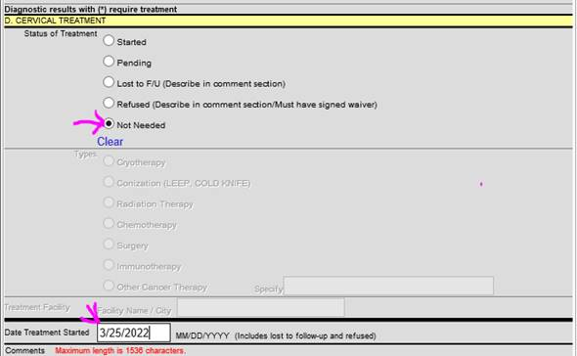
Notes:
In this example the patient had a LSIL/HPV+ pap then Colpo with CIN1 Diagnosis. This Diagnosis does not need treatment so the treatment sections should be left blank. This is incorrect. Leaving the D. Cervical Treatment blank is correct.

Slide 57
PAP TEST DATES
Notes:
This is a blue screening form pap section from MOHSAIC. SMHW would like to ask for dates of the previous pap tests. Please ask the patient about their cervical history and include the date. These dates are important in the timeframe of performing cervical services in following proper ASCCP guidelines. Patient’s should give a date and it should be documented. You may also consider getting a form of medical release to receive the previous pap test.

Slide 58
QUESTIONS/COMMENTS
Thank you for attending the
SMHW Annual Provider Training!
QUESTIONS/COMMENTS???

Slide 59
Missouri Department of Health & Senior Services
Show Me Healthy Women
920 Wildwood Drive, PO Box 570
Jefferson City, MO 65102-0570
Web address: www.health.mo.gov/showmehealthywomen
Telephone: 573-522-2845

