Slide 1
Bureau Update
Missouri Department of Health and Senior Services
Bureau of Home Care and Rehabilitative Standards
Lisa Coots, RN, Administrator

Slide 2
OBJECTIVES
Identify regulatory changes effective in 2019
Discuss Missouri waivers granted for the pandemic
List and Compare top 5 deficient practices for FFY 2019 & FFY2020
Identify trends and statistics for Missouri hospices
Describe an immediate jeopardy and the survey process that follows
Discuss hospice hot topics found beneath the sea

Slide 3
REGULATIONS
&
WAIVERS

Slide 4
New Regulations, Effective 2019
Hospice
42 CFR 418.76 Hospice Aide 42 CFR 418.106 Drugs & Biologicals 42 CFR 418.112 Hospice in a SNF 42 CFR 418.113 Emergency Preparedness

Slide 5
MO HOSPICE WAIVERS
Inspections
19 CSR 30-35.030 (2)
Advance Practice Registered Nurses and Physician Assistants
19 CSR 30-35.010(1)(A)1
Alzheimer care without dementia specific training
19 CSR 30-35.010 (2) (M) 1.B
https://health.mo.gov/living/healthcondiseases/communicable/novel-coronavirus/waivers-laws-rules.php

Slide 6
FFY 2020 TOP FIVE DEFICIENCIES
L530
42 CFR 418.54 (c) (6) Content of Comprehensive Assessment
L591
42 CFR 418.64 (b) (1) Nursing Services
L796
42 CFR 418.76(g)(1) Hospice Aide Assignments and Duties
L774
L625
42 CFR 418.112(d)(2) Hospice Plan of Care
42 CFR 418.114(d)(2) Criminal Background Checks

Slide 7
FFY 2019 TOP FIVE DEFICIENCIES
L591
42 CFR 418.64 (b) (1) Nursing Services
L774
442 CFR 418.112(d)(1) Hospice Plan of Care
L530
42 CFR 418.56 (c) (4) Content of Plan of Care
L625
L549
42 CFR 418.76(g)(1) Hospice Aide Assignments and Duties
42 CFR 418.54 (c) (6) Content of Comprehensive Assessment

Slide 8
TRENDS
&
STATISTICS

Slide 9
Hospice Recertification Surveys
FFY - 2018
32 Recertification
FFY - 2019
FFY - 2020
18 Recertification
7 Follow up Surveys
28 Recertification
8 Follow up Surveys
9 Follow up Surveys

Slide 10
Hospice Complaint Surveys
FFY - 2018
56 Complaints
27- Substantiated
FFY - 2019
FFY - 2020
34 Complaints
25 Substantiated
50 Complaints
29 - Unsubstantiated
25 Substantiated
25 Unsubstantiated
9 Unsubstantiated

Slide 12
Hospice Administration Turnover
First Quarter
Administrator – 16 Supervising RN - 14
Second Quarter
Administrator – 16 Supervising RN - 14
Third Quarter
Administrator – 7 Supervising RN - 8

Slide 13
Hospice - 7
FFY-2019
Home Health - 4
Hospice - 5
FFY-2020
Home Health - 0
Hospice – 2
FFY-2018
Home Health - 3
Immediate
Jeopardy

Slide 14
Immediate Jeopardy
Appendix Q in the SOM, revised July 31, 2019
Three Key Components
Noncompliance with a Condition of Participation
Caused or created a likelihood that serious injury, harm, impairment or death would occur or recur
Immediate action is necessary to prevent the occurrence or recurrence of serious injury, harm, impairment or death

Slide 19
FFY 2018
FFY 2019
Home Health 11
Hospice 8
Home Health 5
Hospice 2
Home Health 16
Hospice 3
FFY 2020

Slide 21
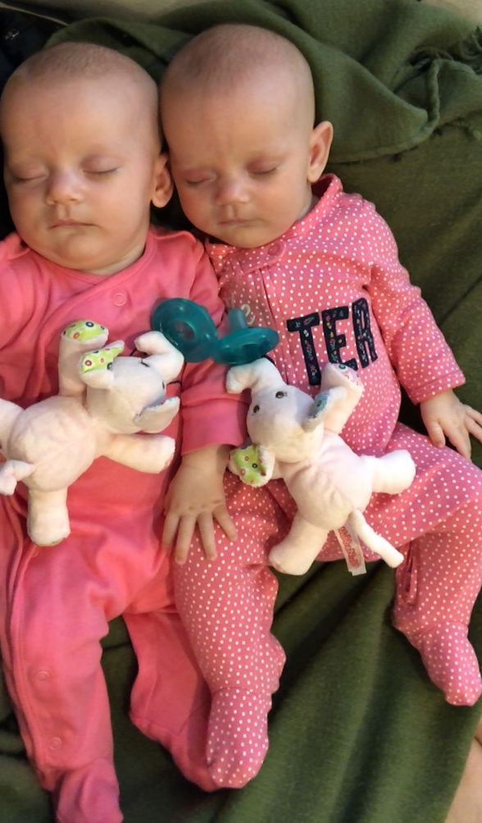

Slide 22
HOT
TOPICS

Slide 23
HOT TOPICS
COVID-19 Pandemic
Hospices not allowed into LTC facilities
Testing hospice staff for COVID
Respite contracts not being honored
Waivers
Proposed regulations
Legislative proposals
Staff change

Slide 24
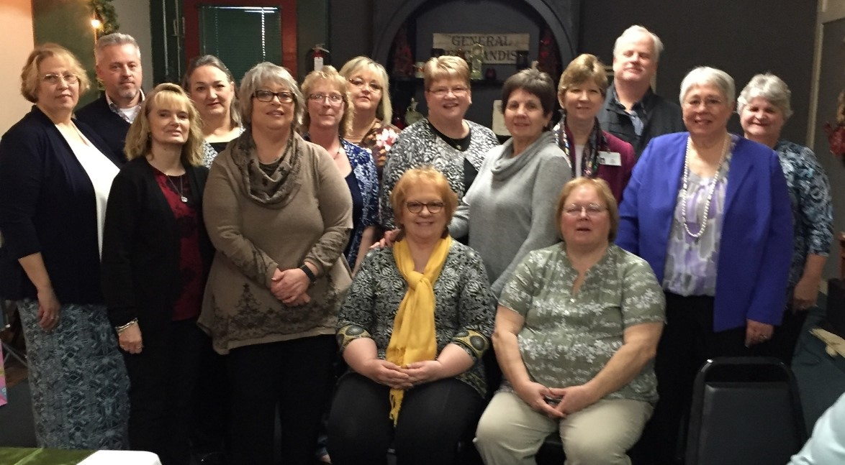

Slide 25
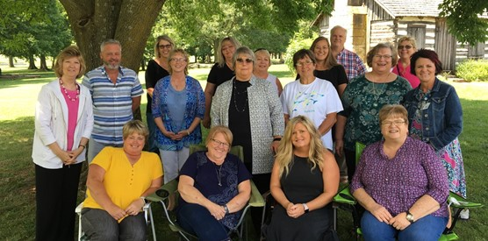

Slide 26
HOT TOPICS Cont.
Coroner bill (HB 2046)
Working remotely
Survey process during pandemic
New legislation could extend respite care days

Slide 27
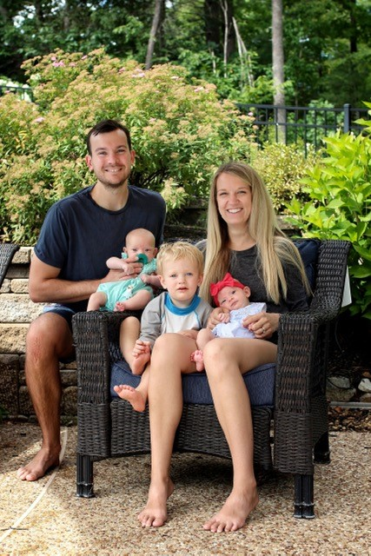

Slide 28
Thank you
www.health.mo.gov/safety/homecare
573/751-6336, option 3 or 573/526-5587
Email questions:
Lisa.Coots@health.mo.gov
Joyce.Rackers@health.mo.gov
Robin.Swarnes@health.mo.gov

